Slide 1

CULTURAL DIVERSITY WEEK
Stakeholder Pack
January 2025
CULTURAL DIVERSITY WE

Slide 2
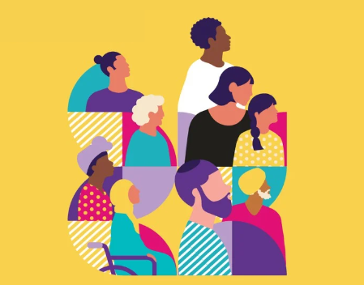
Acknowledgement of Country | 3
Introduction | 4
What you can do to help | 5
Key messaging | 6
Spread the word | 7
Cultural Diversity Week details | 8-10
Creative assets to be shared | 10-16
Key milestones | 17
VMC partners and sponsors | 19
Contact | 20
Contents

Slide 3
Acknowledgement of Country
We acknowledge the Traditional Custodians of the land and pay our respects to their Elders, past and present, and extend that respect to all Aboriginal and Torres Strait Islander peoples.
We recognise their continuing connection to land, waters, and culture, and we honour their invaluable contributions to the rich cultural diversity of Victoria.

Slide 4

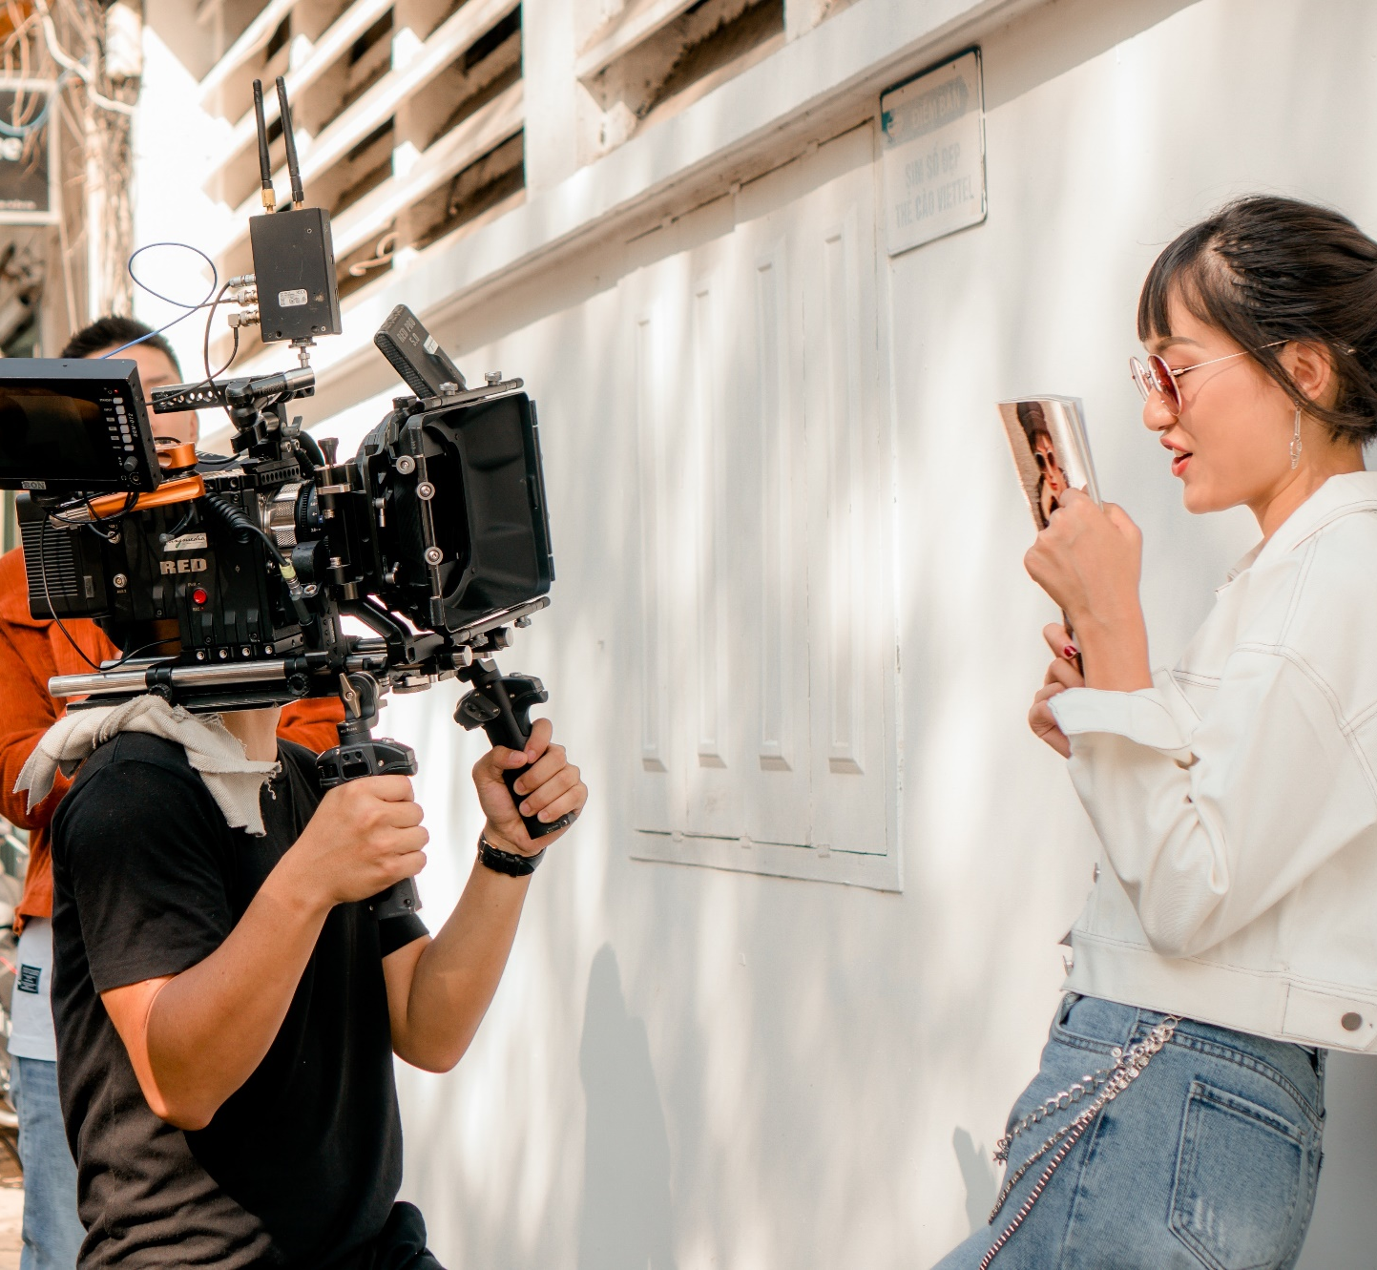
Introduction
Cultural Diversity Week (CDW) is Victoria’s leading multicultural celebration, held annually in March to coincide with the United Nations International Day for the Elimination of Racial Discrimination and Harmony Day on March 21. This week-long initiative from 17 to 23 March showcases the colourful sounds, flavours, sights and traditions of Victoria’s rich and ever-diversifying communities.
Coordinated by the Victorian Multicultural Commission (VMC), Cultural Diversity Week 2025 is dedicated to celebrating the unique journeys and collective stories that define our multicultural identity. This year’s theme, "Embrace the Journey, Shape our Future", invites all Victorians to honour their cultural heritage, share stories of resilience and connection, and explore how culture shapes our present and future.
The week will feature vibrant events, community-led activities, and educational initiatives that foster understanding, inclusion, and respect across the state. By participating, stakeholders like you can help bring to life the vision of a more connected and cohesive society, while celebrating the cultural wealth that makes Victoria unique.

Slide 5
How you can help
You can help by:
Sharing – Spreading the word
Sharing the materials available in this kit with your communities and networks via social media, WhatsApp, WeChat, Messenger and Facebook groups, ensuring that the information reaches diverse audiences and encourages participation
Directing your network to the VMC’s website for further information and updates
Promoting Cultural Diversity Week through your social media channels using the hashtags #CDW2025 and #EmbraceTheJourney to increase awareness and engagement
Participating – Hosting an event or activity
Organise a lunch, workshop, storytelling session or cultural performance to celebrate diversity in your community, workplace or school
Hosting or encouraging participation in Harmony Walks, cultural showcases or other public activities that bring people together to embrace the week’s theme of connection and inclusion.
Upload your activity or event to VMC Connect and include #CDW2025 on socials to be eligible for the prize
Celebrating - Join our digital campaign
Celebrate Cultural Diversity Week 2025 by encouraging individuals to share their cultural stories through a short video, photo, or written reflection.
Post using #CDW2025 and #EmbraceTheJourney to be featured and for a chance to win exclusive prizes!
Resources:
Creative assets available here
Cultural Diversity Week website here
Share your event on VMC Connect here
Utilise hashtags: #CDW2025 #EmbraceTheJourney #ShapeOurFuture
Tag us on Facebook/ Instagram: @multiculturevic
Tag us on LinkedIn: victorian-multicultural-commission

Slide 6
Key messaging
Cultural Diversity Week will run from 17 to 23 March 2025!
Cultural Diversity Week is a time to celebrate the power, influence and stories of Victoria's rich multicultural communities
All Victorians are invited to participate through a variety of in-person events and activities
This year’s theme, "Embrace the Journey, Shape our Future," celebrates the stories, traditions and evolving identities that make Victoria a vibrant multicultural state
Proudly led by the Victorian Multicultural Commission, Cultural Diversity Week is an opportunity for individuals, schools, workplaces and communities to come together to celebrate and promote the value of cultural diversity
Be part of the celebration! Host an event, attend activities or share your cultural story
The Victorian Multicultural Festival will be held at Grazeland from 21 to 23 March, in line with Cultural Diversity Week

Slide 7
Help spread the word!
Help spread the word about Cultural Diversity Week 2025!
Cultural Diversity Week is a celebration of Victoria’s vibrant multicultural identity, running from Monday 17 March to Sunday 23 March 2025. This year’s theme, "Embrace the Journey, Shape our Future," highlights the unique and collective stories that define our communities and encourages meaningful connections across cultures.
Let’s work together to amplify the message and encourage everyone to get involved in this special week of connection, celebration and cultural exchange. Whether you’re a school, workplace, community group or individual, there are countless ways to celebrate and promote the importance of cultural diversity.
You can help to spread the word or become a part of the cultural diversity celebration in the following ways:
HOST AN EVENT/ ACTIVITY
Encouraging organisations to host an event. Register your event on VMConnect, the online hub for multicultural events in Victoria
JOIN OUR DIGITAL CAMPAIGN
Amplify community voices and stories. Record a short video, photo or narrative, and post it on social media using #CDW2025
ATTEND THE VICTORIAN MULTICULTURAL FESTIVAL
Attend the flagship event to celebrate and unite diverse communities, 21–23 March at the iconic Grazeland, Spotswood

Slide 8
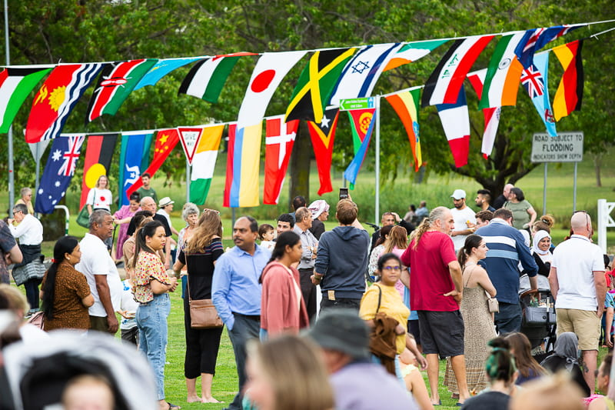
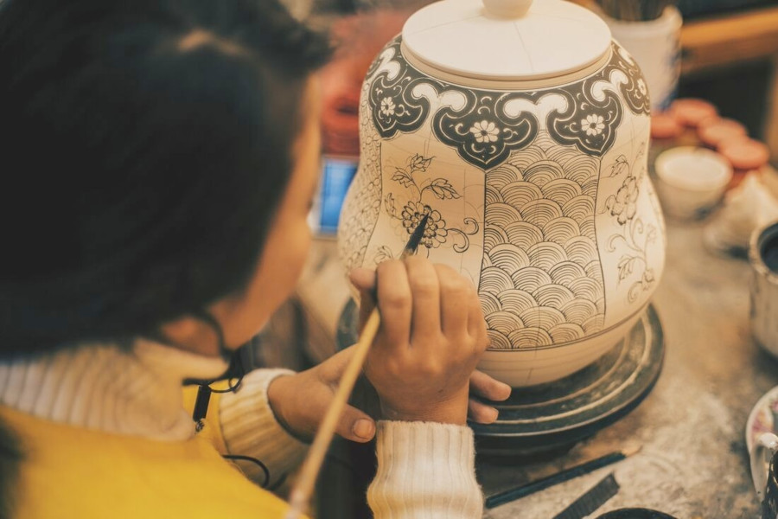
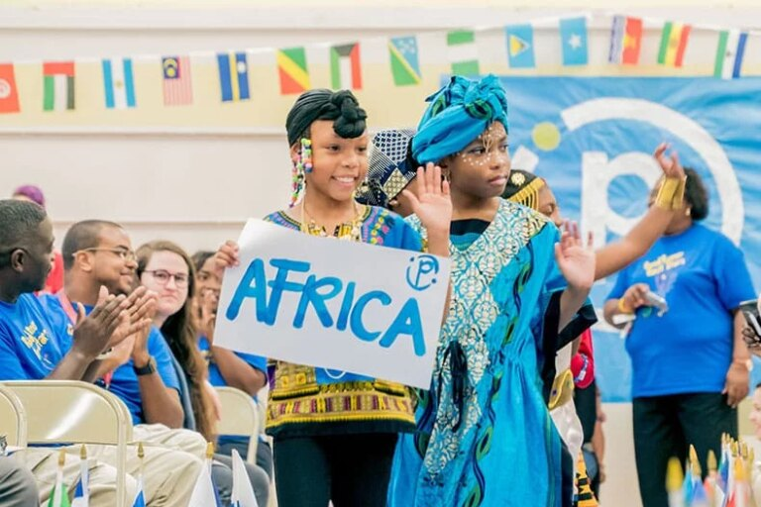
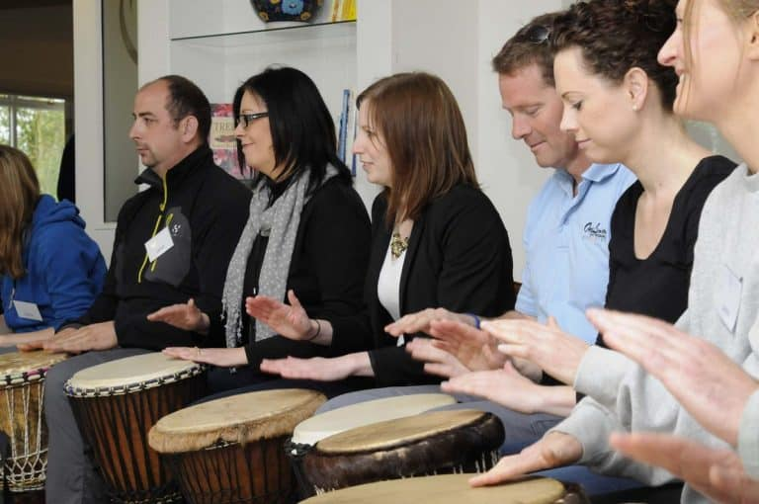
Participate: Host an event or activity
The VMC team would like to encourage Government departments, community groups, schools or businesses to get involved and facilitate their own multicultural events/ activities as part of Cultural Diversity Week brought to life through the tagline. Please see below ideas:
Embrace the Journey
Organise a Taste of Harmony Lunch in your workplace catered by a social enterprise
Showcase the talents and traditions of culturally diverse people in your community by holding a festival in your local area
Create opportunities for community members to actively participate through activities like cooking demonstrations, craft-making sessions, and storytelling circles
Share images and stories of culturally significant places you have visited
Work with local businesses, schools, and community groups to co-create events and campaigns that resonate with their unique cultural identities and priorities
Organise a movie night to celebrate multicultural films
Offer language lessons, craft workshops, or cultural dance classes
Celebrate multicultural fashion through a runway at an event
Shape our Future
Use the VMC’s Cultural Diversity Week Teacher's Resource Kit to inspire conversations, even if you're not in school!
Promote cultural diversity and challenge racism in the workplace by completing the Australian Human Rights Commission Workplace Cultural Diversity Tool with your team
Book a course on human rights and equality through the Victorian Equal Opportunity and Human Rights Commission
Share your favourite publications (books, magazines or articles) that discuss issues of race, racism, belonging and identity
Discuss the Anti Racism Strategy at your all staff meetings
Run a Harmony Walk at your organisation
Lunchtime panels – Key prolific people debating on contentious topics
Host a traditional dress day where participants wear attire representing their heritage
Prizes to be won!
Make sure you upload your activity or event to VMC Connect and include #CDW2025 on socials to be eligible for the prize.
More details can be found here

Slide 9
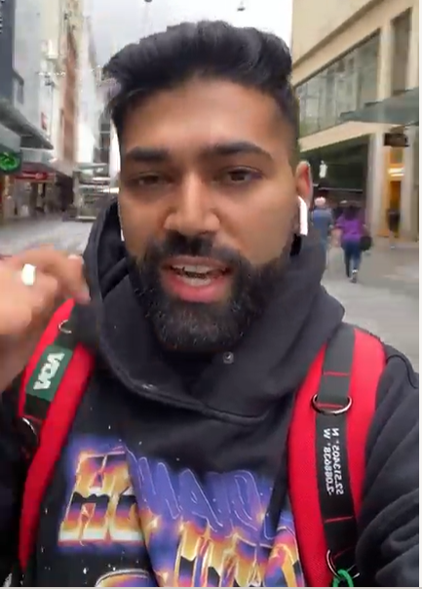
Celebrate: Join our digital campaign
This year’s theme, "Embrace the Journey, Shape our Future", highlights the importance of honouring the diverse cultures that make up Victoria’s vibrant community. We invite you to participate by creating a short video (30–90 seconds) on behalf of your culture to celebrate Cultural Diversity Week and promote the festival. There are also prizes to be won! The video can highlight: Your connection to multiculturalism and how it influences your values, your commitment to cultural diversity and why it is important to you or any initiatives or work you’ve done to promote inclusivity in your community.
How your organisation can participate:
Keep It short and sweet – Videos should be 30–90 seconds long.
Film in portrait orientation – Ideal for social media platforms.
Introduce your organisation – Share your name, your role, and a bit about the organisation. For example: “Hello, I’m [Your Name], [Your Role] at [Organisation Name], and we’re proud to celebrate Victoria’s multicultural community.”
Highlight your multicultural connection –
  Share your organisation’s efforts in embracing diversity or fostering connections across communities.
  Reflect on why multiculturalism matters to your mission and how it has shaped your work.
End with a commitment – Express pride in being part of Victoria’s multicultural community and your organisation’s continued dedication to celebrating diversity.
Share your video – Post the video on your social media channels starting 1 March 2025 to build momentum for CDW.
Tag @VictorianMulticulturalCommission and include the hashtags: #EmbraceTheJourney #CDW2025 #CulturalDiversityWeek #ShapeOurFuture
We encourage you to have some fun with it! Make the video feel authentic, with natural, engaging messages. The more personal and creative, the better (in a culturally sensitive way). You might want to consider incorporating the variety of languages spoken at your organisation – for example, staff could share a message in the different languages they speak. This adds a unique and impactful touch to the message.
We’re excited to see how your organisation embraces this year’s theme and celebrates Victoria’s incredible diversity during Cultural Diversity Week 2025. Please let us know if you will be supporting our campaign so we could update our database accordingly.
Please note: If you are using footage of individuals under 18, please ensure you have photo/video consent to cover all bases.
Digital content example:
Click here to watch
Click here to learn more

Slide 10

Suggested social media content:
Cultural Diversity Week
Suggested post copy:
Static social tile
We’re proud to be celebrating Cultural Diversity Week 2025!
From 17–23 March, we’ll join communities across Victoria to celebrate the stories, traditions, and contributions that make our state a vibrant multicultural success.
This year’s theme, "Embrace the Journey, Shape our Future," is a powerful reminder of how diversity and inclusion help us build a stronger, more connected future.
Be part of the celebration! Host an event, attend activities or share your cultural story. Register your event on VMConnect, Victoria’s online hub for multicultural events: https://www.multiculturalcommission.vic.gov.au/cultural-diversity-week-victorian-multicultural-commission.
All participants who host an event or activity will be entered automatically into the draw to win prizes that include:
2 x VIP tickets to the Multicultural Film Festival Premiere
News story feature on the VMC website and EDM newsletter
Social media coverage
VMC Commissioner to speak at one of your events
A featured spot on the Victorian Multicultural Commission’s social media and website
Let’s come together to celebrate, connect and showcase the incredible multicultural spirit that defines Victoria.
#CulturalDiversityWeek #CDW2025 #EmbraceTheJourney #ShapeOurFuture
Click here to download

Slide 11
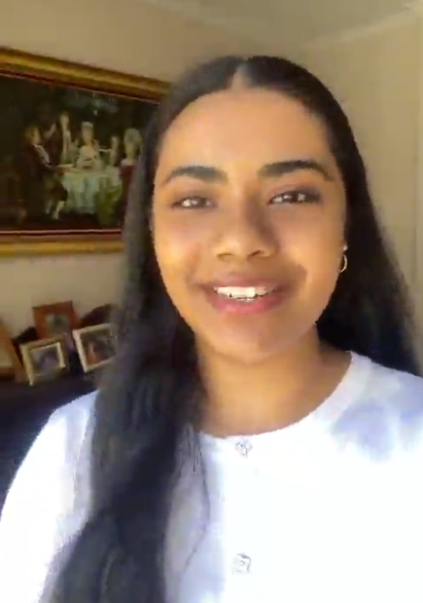
Suggested social media content:
Digital campaign
Suggested post copy
Digital content example:
Join us in celebrating Cultural Diversity Week by sharing your unique cultural stories!
The Victorian Multicultural Commission invites everyone to participate by showcasing their favourite traditions, languages or meaningful cultural experiences. Record a short video, capture a photo or write a narrative, then share it on social media using #CDW2025, #EmbraceTheJourney, and #ShapeOurFuture.
Don’t forget to tag @multiculturevic to be featured!
All participants will be entered into an automatic draw to win exciting prizes, including:
2 x VIP tickets to the Multicultural Film Festival Premiere
A featured spot on the Victorian Multicultural Commission’s social media and website
Let’s honour the past, celebrate the present, and shape a multicultural future together.
#CulturalDiversityWeek #CDW2025 #EmbraceTheJourney #ShapeOurFuture
Click here to watch

Slide 12
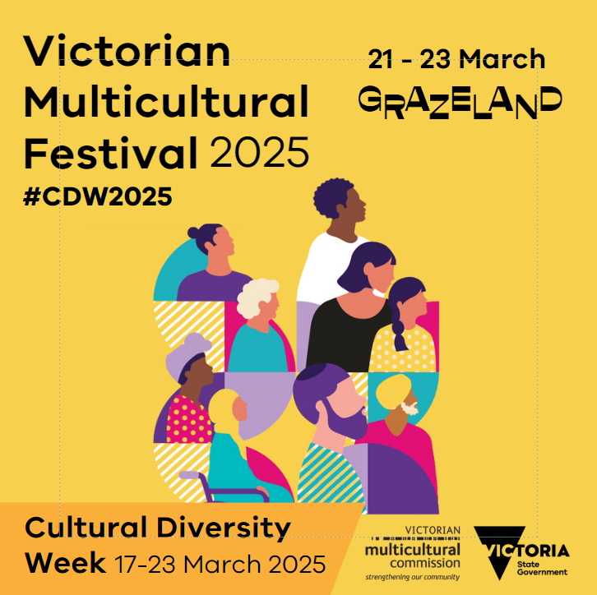

Suggested social media content:
Victorian Multicultural Festival
Suggested post copy
Join us to celebrate Cultural Diversity Week at the flagship Cultural Diversity Festival 2025!
Taking place from 21–23 March 2025 at the iconic Grazeland in Spotswood, this vibrant festival is the ultimate celebration of Victoria’s multicultural communities, packed with food, entertainment and culture.
🌍 Explore Global Flavours
Indulge in an outdoor dining experience featuring cuisine from around the globe – perfect for food lovers!
🎶 Non-Stop Entertainment
Enjoy live music, cultural performances and activities for all ages, making it the ideal outing for families and friends.
🎨 Dress for the Occasion
Wear your favourite cultural attire or colours and celebrate diversity in style!
🎟️ Event Highlights
$4 entry fee (children under 12 enter free)
Gates open Friday evening and from noon on Saturday and Sunday
Bring your family and friends – we can’t wait to see you there!
Visit the Cultural Diversity Week website for full event details: https://www.multiculturalcommission.vic.gov.au/cultural-diversity-week-victorian-multicultural-commission
#CulturalDiversityFestival #CulturalDiversityWeek #CDW2025 #EmbraceTheJourney #ShapeOurFuture #Grazeland
Static social tile
Animated social story
Click here to download
Click here to download

Slide 13


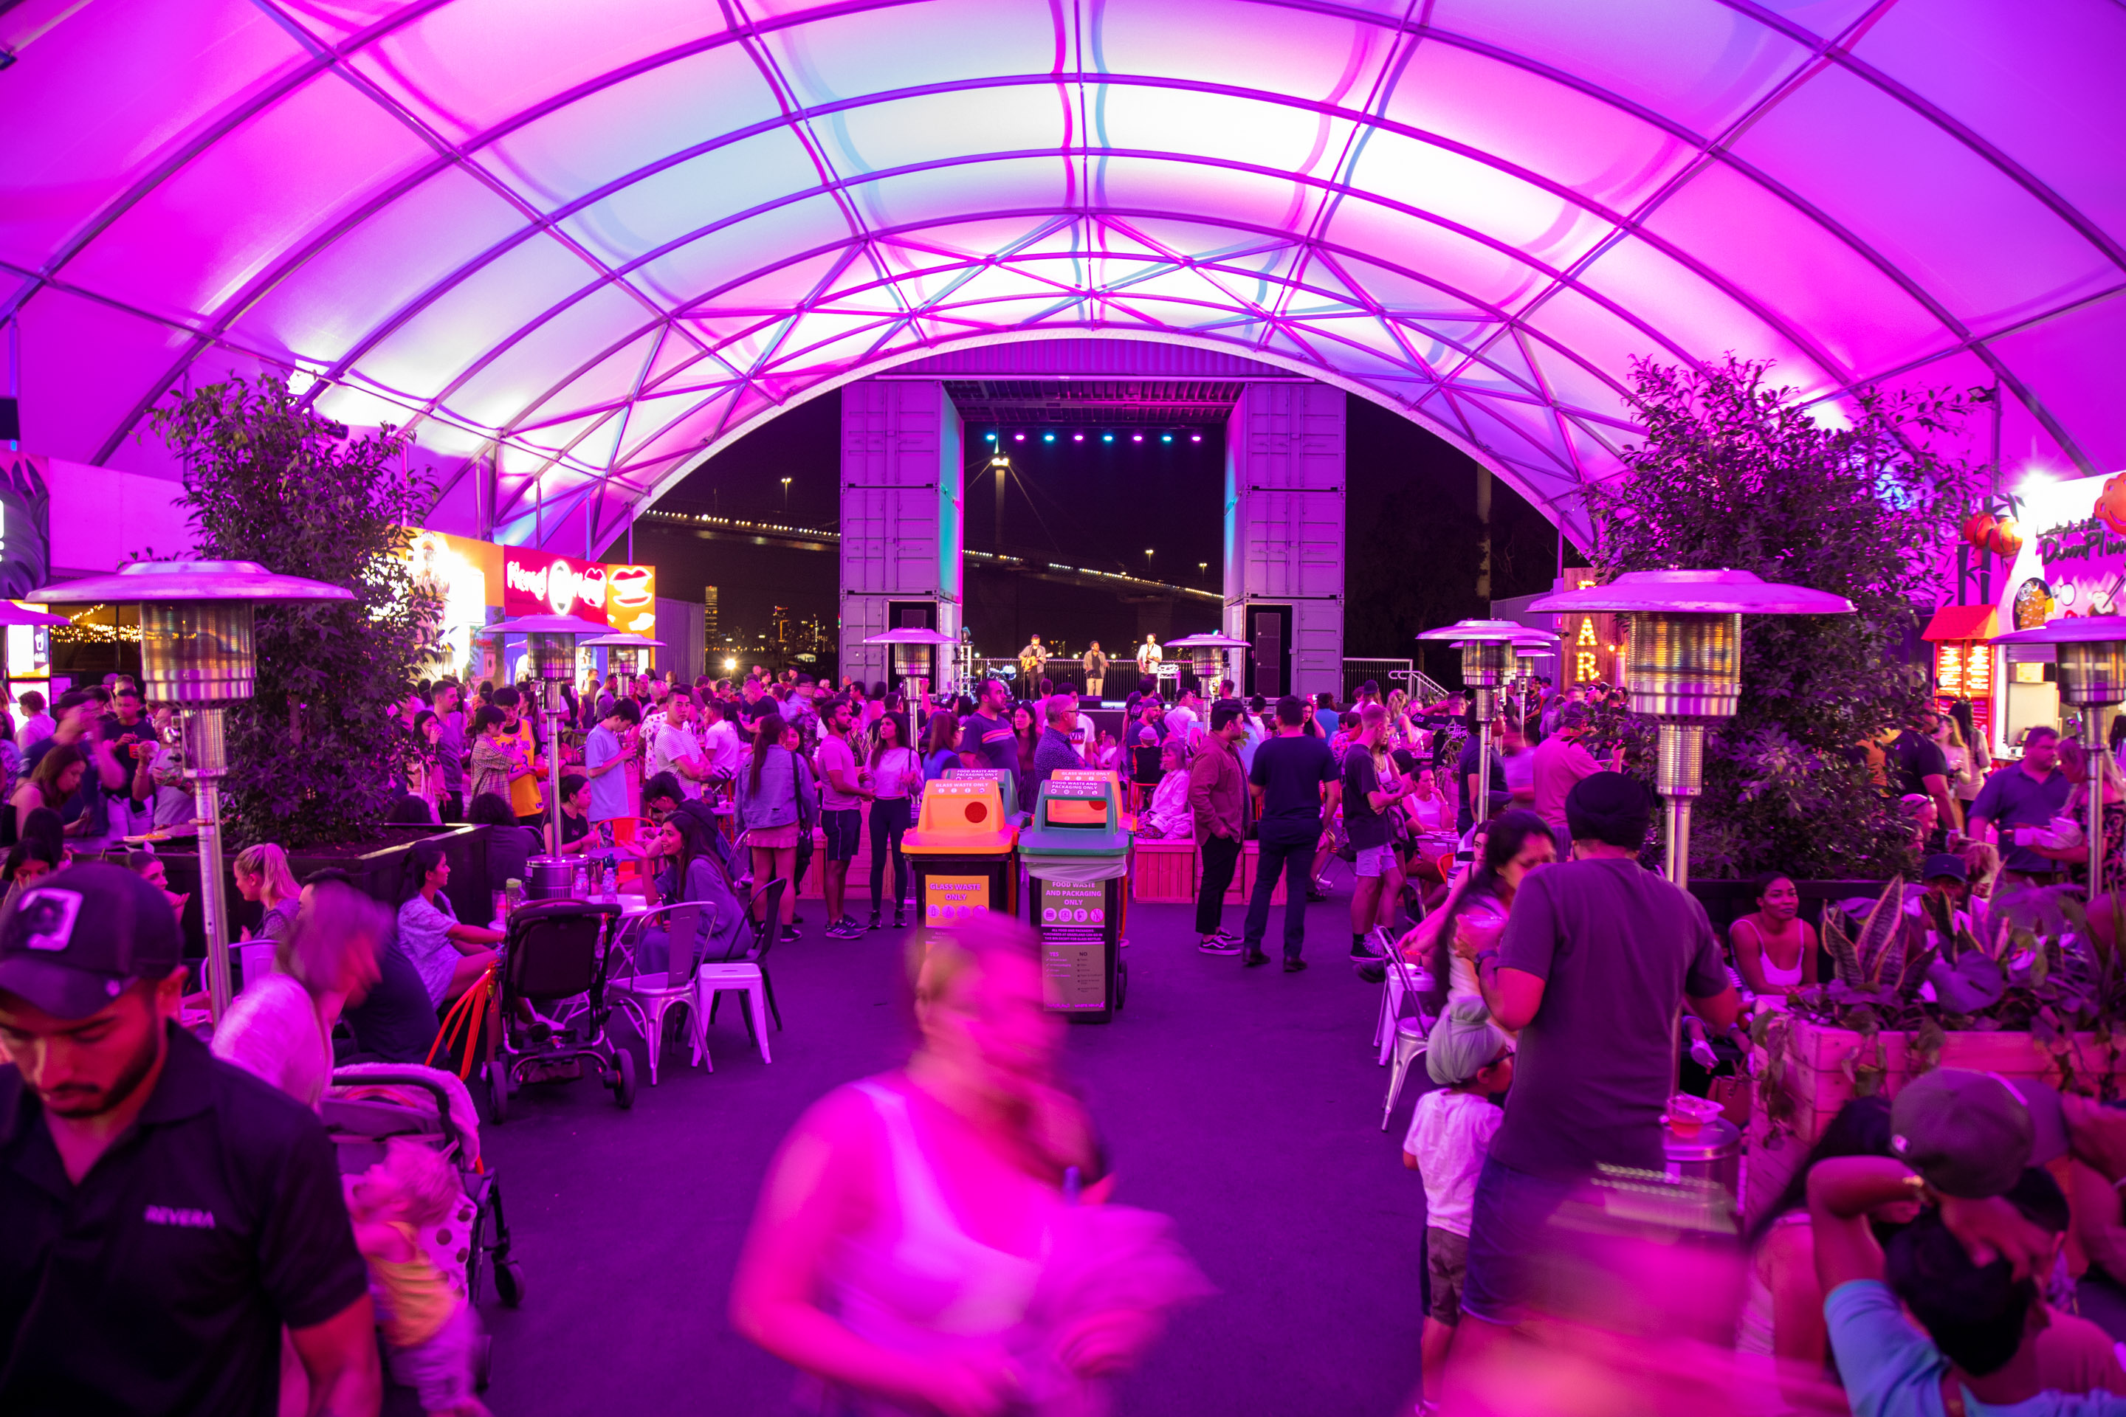
Newsletter header (EDM)
Suggested EDM Content
Get ready for Cultural Diversity Week 2025—Victoria’s biggest celebration of multiculturalism!
From 17–23 March, immerse yourself in a week of vibrant events, inspiring storytelling, and cultural pride as we come together to honour the stories, traditions, and contributions that make Victoria extraordinary.
Whether you're hosting an event, joining the flagship Cultural Diversity Festival, or sharing your cultural story online, there’s a way for everyone to get involved.
🌟 Host or Register an Event
Make your community a part of the celebration! Register your event on VMConnect, the online hub for multicultural events in Victoria: Visit the Cultural Diversity Week website for details.
🌟 Be Part of Our Digital Campaign
Celebrate this year’s theme, "Embrace the Journey, Shape Our Future," by sharing your unique cultural story. Record a short video, photo, or narrative, and post it on social media using #CDW2025, #EmbraceTheJourney, and #ShapeOurFuture. Don’t forget to tag @multiculturevic to be featured.
🎁 All participants who host and event or create a video will go into a draw to win exciting prizes. See website for more details.
🌟 Join the Flagship Event: Cultural Diversity Festival 2025
Taking place from 21–23 March at the iconic Grazeland in Spotswood, this festival is packed with global flavours, vibrant entertainment, and cultural pride:
Indulge in cuisine from around the globe.
Enjoy live music, cultural performances, and family-friendly activities.
Wear your favourite cultural attire or colours and celebrate diversity in style!
🎟️ Entry: $4 (children under 12 free)
Let’s honour the past, celebrate the present, and shape a multicultural future together.
#CulturalDiversityWeek #CDW2025 #EmbraceTheJourney #ShapeOurFuture
Newsletter header

Slide 14


Internal Creative*
*The VMC have developed a Zoom or Microsoft Teams background and email signature to help you promote Cultural Diversity Week .
Virtual background creative
Email signature
Creative assets available here

Slide 15


Social Media Banners
*The VMC have developed social media event banners to help promote your events
Facebook cover banner
LinkedIn banner
Creative assets available here

Slide 16


Promotional poster*
*Please note that posters can be adjusted to be printed in A4 or A3 or can be used as a digital flyer/ screen to promote Cultural Diversity Week
A4/A3 Poster
Creative assets available here

Slide 17
Key milestones*
*The VMC encourages our partners/stakeholders to promote CDW at key milestones leading to the festival. The VMC will provide updated assets at each milestone.
 | March 2025
MILESTONES | 3 | 10 | 17 | 24 | 31
Entries open for Digital campaign: 1 March 2025
Entries close for digital campaign: 30 March 2025
Entries open for participation (Host event/activity): 17 March 2025
Cultural Diversity Week Begins: 17 March 2025
Victorian Multicultural Festival: 21 to 23 March 2025
Winners announced

Slide 18

CDW coincides with important observances
Cultural Diversity Week coincides with several important cultural and religious observances, enriching our collective celebration of diversity and inclusion. Here are a few examples:
Ramadan (begins evening of 27 February – ends evening of 30 March 2025) – A sacred month of fasting, prayer, and reflection observed by Muslims worldwide
Holi (Friday, 21 March 2025): A vibrant festival celebrated by the Hindu faith, marking the arrival of spring with colours, music, and joy, bringing communities together worldwide.
Harmony Day (Friday, 21 March 2025): An Australian celebration promoting inclusiveness, respect, and belonging.
Acknowledging and respecting diverse observances:
These important celebrations don't take away from CDW; in fact, they strengthen it.
It's important to acknowledge these significant observances while celebrating CDW.
We encourage stakeholders to consider these dates and ensure their CDW activities are respectful and inclusive of all cultures and faiths.

Slide 19










Cultural Diversity Week partners and sponsors
Media Partner
Delivery Partner
Major Partner
Event Partner
Promotion Partner
Supporting Partners

Slide 20

Contact
Thank you
For more information, please contact:
communications@vmc.vic.gov.au
Follow us

